Slide 1
Logic and Computer Design Fundamentals
Chapter 4 – Sequential Circuits
Part 1 – Storage Elements and Sequential Circuit Analysis
College of Computer Science and Technology, Zhejiang University

Slide 2
Overview
Part 1 - Storage Elements and Analysis
  Introduction to sequential circuits
  Types of sequential circuits
  Storage elements
    Latches
    Flip-flops
  Sequential circuit analysis
    State tables
    State diagrams
  Circuit and System Timing
Part 2 - Sequential Circuit Design
    Specification
    State Assignment
    Designing
Chapter 5 - Part 1 <number>

Slide 3
Introduction to Sequential Circuit
Inputs
Combinational
Logic
Outputs
Consist of:
  Storage elements:
  Latches or flip-flops
  Combinational Logic:
    Implement a function of inputs
    Inputs are signals from the outside
    Outputs are signals to the outside
    Other Signals: Present State, signal from the storage elements
    Other output, Next state: input of storage element
Storage Elements
Next State
State
Chapter 5 - Part 1 <number>

Slide 4
Introduction to Sequential Circuit
Combinational Logic
  Function of next state
  Next State= f(Inputs, Present State)
  Output Function(Mealy)
  Output = g(Inputs, State)
  Output Function(Moore)
  Output = h (Present State)
  The type of output function depends on the functionality, and have a great impact on the design
Inputs
Combinational
Logic
Outputs
Storage Elements
Next State
State
Chapter 5 - Part 1 <number>

Slide 5
Types of Sequential Circuits
Depends on the times at which:
  storage elements observe their inputs, and
  storage elements change their state
Synchronous
  Behavior defined by knowledge of its signals at discrete instances of time
  Storage elements observe inputs and can change state only in relation to a timing signal (clock pulses from a clock)
Asynchronous
  Behavior defined by knowledge of inputs at any instant of time and the order in continuous time in which inputs change
  If clock is regarded as another input, all circuits are asynchronous!
  Nevertheless, the synchronous abstraction makes complex designs tractable!
Chapter 5 - Part 1 <number>

Slide 6
Discrete Event Simulation
In order to understand the time behavior of a sequential circuit we use discrete event simulation.
Rules:
  Gates modeled by an ideal (instantaneous) function and a fixed gate delay
  Any change in input values is evaluated to see if it causes a change in output value
  Changes in output values are scheduled by a fixed gate delay after the input change
  At the time for a scheduled output change, the output value is changed along with any inputs it drives
Chapter 5 - Part 1 <number>

Slide 7
Simulated NAND Gate
Example: A 2-Input NAND gate with a 0.5 ns delay:
Assume A and B have been 1 for a long time
At time t=0, A changes to a 0 and at t= 0.8 ns, back to 1.
F(I)
A
DELAY 0.5 ns.
F
B
t (ns)
A
B
F(I)
F
Comments
–
∞
1
1
0
0
A=B=1 for a long time
0
1
⇒
0
1
1
⇐
0
0
F(I) changes to 1
0.5
0
1
1
1
⇐
0
F changes to 1 after a 0.5 ns delay
0.8
1
⇐
0
1
1
⇒
0
1
F(I) changes to 0
1.3
1
1
0
1
⇒
0
F changes to 0 after a 0.5 ns delay
Chapter 5 - Part 1 <number>

Slide 8
Gate Delay Models
Suppose gates with delay n ns are represented for n = 0.2 ns, n = 0.4 ns, n = 0.5 ns, respectively:
0.2
0.4
0.5
Chapter 5 - Part 1 <number>

Slide 9
Gate Delay Models
A
Consider a simple of 2-input multiplexer with function:
  Y = A for S = 0
  Y = B for S = 1
“Glitch” is due to delay of inverter
0.4
0.2
Y
0.5
S
B
0.4
A
B
S
S
Y
Chapter 5 - Part 1 <number>
Notes:
有一小段s和~s都为0

Slide 10
Storing State
What if Y connected
to A?
Circuit becomes:
With function:
  Y = B for S = 1, and
  Y(t) dependent on
  Y(t – 0.9) for S = 0
The simple combinational circuit now becomes a sequential circuit because its output is a function of a time sequence of input signals!
0.4
0.2
0.5
S
Y
B
0.4
B
S
S
Y
Y is stored value in shaded area
Chapter 5 - Part 1 <number>

Slide 11
Storing State (Continued)
Simulation example as input signals change with time. Changes occur every 100 ns, so that the 1 ns delays are negligible.
Y represents the state of the circuit, not only an output.
Time
B
S
Y
Comment
1
0
0
Y “remembers” 0
1
1
1
Y = B when S = 1
1
0
1
Now Y “remembers” B = 1 for S = 0
0
0
1
No change in Y when B changes
0
1
0
Y = B when S = 1
0
0
0
Y “remembers” B = 0 for S = 0
1
0
0
No change in Y when B changes
Chapter 5 - Part 1 <number>
Notes:
Note that the “glitch” is still present. An actual storage circuit would be designed to eliminate this by addition of term BY.

Slide 12
Storing State (Continued)
Suppose we place
an inverter in the
“feedback path”
The following are behavior results:
The circuit is said
to be unstable.
For S = 0, the
circuit becomes
what is called an
oscillator. Can be
used as crude clock.
0.4
0.2
0.2
0.5
S
Y
B
0.4
B
S
Y
Comment
0
1
0
Y = B when S = 1
1
1
1
1
0
1
Now Y “remembers” 1
1
0
0
Y changes after 1.1 ns
1
0
1
Y changes after 1.1 ns
1
0
0
Y changes after 1.1 ns
Chapter 5 - Part 1 <number>
Notes:
最后一个inverter修正了Y值

Slide 13
Basic (NAND) S – R Latch
“Cross-Coupling” two NAND gates gives the S -R Latch:
Which has the time sequence behavior:
S = 0, R = 0 is
forbidden as
input pattern
S (set)
Q
Q
R (reset)
Time
R
S
Q
Q
Comment
1
1
?
?
Stored state unknown
1
0
1
0
“Set” Q to 1
1
1
1
0
Now Q “remembers” 1
0
1
0
1
“Reset” Q to 0
1
1
0
1
Now Q “remembers” 0
0
0
1
1
Both go high
1
1
?
?
Unstable!
Chapter 5 - Part 1 <number>
Notes:
S=0,R=0是保持，表示remember

Slide 14
Basic (NOR) S – R Latch
Cross-coupling two
NOR gates gives the
S – R Latch:
Which has the time sequence behavior:
R (reset)
Q
S (set)
Q
Time
R
S
Q
Q
Comment
0
0
?
?
Stored state unknown
0
1
1
0
“Set” Q to 1
0
0
1
0
Now Q “remembers” 1
1
0
0
1
“Reset” Q to 0
0
0
0
1
Now Q “remembers” 0
1
1
0
0
Both go low
0
0
?
?
Unstable!
Chapter 5 - Part 1 <number>

Slide 15
Clocked S - R Latch
Adding two NAND
gates to the basic
S - R NAND latch
gives the clocked
S – R latch:
S
Q
C
Q
R
Has a time sequence behavior similar to the basic S-R latch except that the S and R inputs are only observed when the line C is high.
C means “control” or “clock”.
Chapter 5 - Part 1 <number>

Slide 16
Clocked S - R Latch (continued)
The Clocked S-R Latch can be described by a table:
The table describes
what happens after the
clock [at time (t+1)]
based on:
  current inputs (S, R, C)
C | S | R | Q(t + 1)
0 | X | X | No change
1 | 0 | 0 | No change
1 | 0 | 1 | Q=0：Clear Q
1 | 1 | 0 | Q=1：Set Q
1 | 1 | 1 | Undefined
S
Q
C
Q
R
Chapter 5 - Part 1 <number>

Slide 17
D Latch
Adding an inverter
to the S-R Latch,
gives the D Latch:
Note that there are
no “indeterminate”
states!
D
Q
C
Q
The graphic symbol for a D Latch is:
C | D | Q(t + 1)
0 | X | No change
1 | 0 | Q=0: Clear Q
1 | 1 | Q=1：Set Q
D
Q
C
Q
Chapter 5 - Part 1 <number>

Slide 18
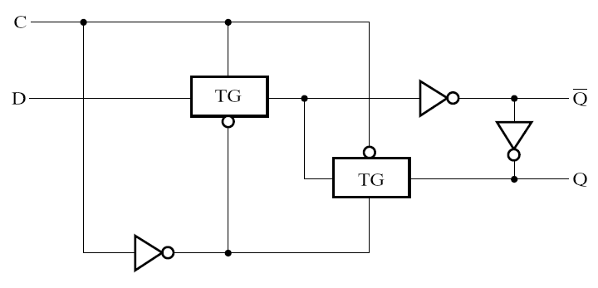
D Latch with Transmission Gates
Chapter 5 - Part 1 <number>

Slide 19
Flip-Flops
The latch timing problem
Master-slave flip-flop
Edge-triggered flip-flop
Standard symbols for storage elements
Direct inputs to flip-flops
Flip-flop timing
Chapter 5 - Part 1 <number>

Slide 20
The Latch Timing Problem
Consider the following circuit:
Suppose that initially Y = 0.
As long as C = 1, the value of Y continues to change!
The changes are based on the delay present on the loop through the connection from Y back to Y.
This behavior is clearly unacceptable.
Desired behavior: Y changes only once per clock pulse
Y
D
Q
Clock
C
Q
Clock
Y
Chapter 5 - Part 1 <number>
Notes:
时序问题

Slide 21
The Latch Timing Problem (continued)
In a sequential circuit, combinational logic may include the followings paths:
  From one storage element to another
  From a storage element back to the same storage element
The combinational logic between a latch output and a latch input may be as simple as an interconnect
For a clocked D-latch, any change of input D can result in a change of output Q whenever the clock input C has value 1
Chapter 5 - Part 1 <number>

Slide 22
The Latch Timing Problem (continued)
A solution to the latch timing problem is to break the inner path from input to output within the storage element
The commonly-used, path-breaking solutions are:
  a master-slave flip-flop
  an edge-triggered flip-flop
Chapter 5 - Part 1 <number>

Slide 23
S-R Master-Slave Flip-Flop
The input is observed by the first latch when C = 1
The output is changed by the second latch when C = 0
The path from input to output is broken by the difference of the clocking values (C = 1 and C = 0).
The behavior demonstrated in the previous example can be prevented since a change of Y based on D won’t occur until the clock changes from 1 to 0.
Consists of two clocked
S-R latches in series
with the clock on the
second latch inverted
S
S
S
Q
Q
Q
C
C
C
R
R
Q
R
Q
Q
Chapter 5 - Part 1 <number>

Slide 24
Flip-Flop Problem
The change in the flip-flop output is delayed by the pulse width ,which makes the circuit slower
S and/or R are permitted to change while C = 1
  Suppose Q = 0 and S goes to 1 and then back to 0 with R remaining at 0
    The master latch sets to 1
    A 1 is transferred to the slave
  Suppose Q = 0 and S goes to 1 and back to 0 and R goes to 1 and back to 0
    The master latch sets and then resets
    A 0 is transferred to the slave
  This behavior is called 1s catching
Chapter 5 - Part 1 <number>

Slide 25
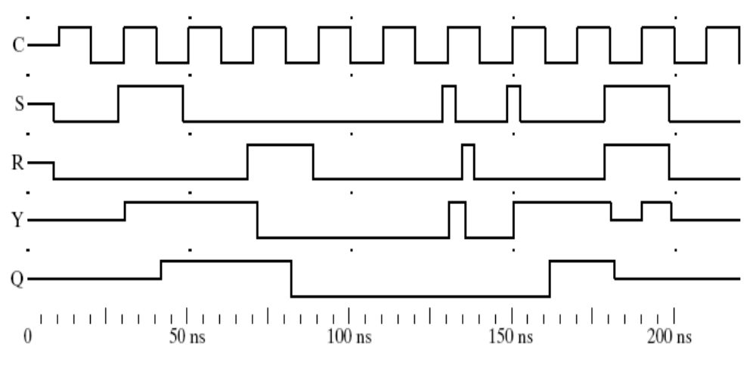
S-R Master-Slave Flip-Flop Timing Parameters
_{Y}
S
S
Q
S
Q
Q
C
C
C
R
R
Q
R
Q
Q
5
1
0
0
3
Keep 0
6
2
4
_{Reason:} _{SR=11,} _{Input state is illegal}
Before the arrival of pulse: Q=0
Before the end of the pulse: RS=00, Q should keep “0”
Disposable sampling
Chapter 5 - Part 1 <number>

Slide 26
Flip-Flop Solution
Use edge-triggering instead of master-slave
An edge-triggered flip-flop ignores the pulse while it is at a constant level and triggers only during a transition of the clock signal
Edge-triggered flip-flops can be built directly at the electronic circuit level, or
A master-slave D flip-flop which also exhibits edge-triggered behavior can be used.
Chapter 5 - Part 1 <number>

Slide 27
Edge-Triggered D Flip-Flop
It can be formed by:
  Replacing the first clocked S-R latch with a clocked D latch or
  Adding a D input and inverter to a master-slave S-R flip-flop
The delay of the S-R master-slave flip-flop can be avoided since the 1s-catching behavior is not present with D replacing S and R inputs
The change of the D flip-flop output is associated with the negative edge at the end of the pulse
It is called a negative-edge triggered flip-flop
The edge-triggered D flip-flop is the same as the master-slave D flip-flop
D
D
Q
S
Q
Q
C
C
C
Q
R
Q
Q
Chapter 5 - Part 1 <number>
Notes:
因为没有了s=0,R=0这个维持步，所以只谈边缘触发

Slide 28
Positive-Edge Triggered D Flip-Flop
Formed by
adding inverter
to clock input
D
D
Q
S
Q
Q
C
C
C
Q
R
Q
Q
Q changes to the value on D applied at the positive clock edge within timing constraints to be specified
Our choice as the standard flip-flop for most sequential circuits
Q(t) is the current output of flip-flop while D(t) is the current input, and Q(t+1) represent the next output, then we have:
Q(t+1) = D(t)
Chapter 5 - Part 1 <number>

Slide 29
Positive-Edge-Triggered D Flip-Flop
Circuit for Problem 5-3
S
D
Q
S
D FF
2
Cp
Q
R
Ⅱ
(
b
)
Logic Symbol
4
6
Q
Ⅰ
Asynchronous
Positive-Edge-Triggered
R
S
Cp
D
Q
Q
3
5
Q
0
1
X
X
0
1
Ⅲ
1
0
X
X
1
0
D
1
1
1
0
0
1
1
1
1
1
0
R
(
c
)
Function Table
(
a
)
Logic Circuit

Slide 30
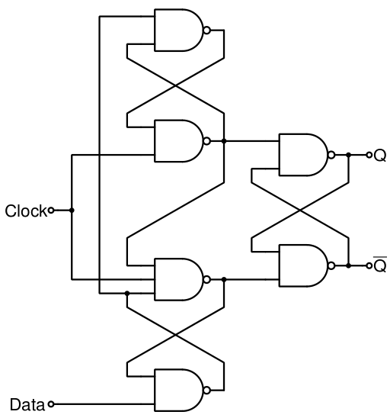
Actual Circuit of Edge-Triggered D Flip-Flop
Complicated to be analyzed
Chapter 5 - Part 1 <number>

Slide 31
Standard Symbols for Storage Elements
Master-Slave:
Postponed output
indicators
Edge-Triggered:
Dynamic
indicator
S
S
D
D
R
R
C
C
SR
SR
D with 1 Control
D with 0 Control
(a) Latches
S
S
D
D
C
C
R
R
C
C
Triggered SR
Triggered SR
Triggered D
Triggered D
(b) Master-Slave Flip-Flops
D
D
C
C
Triggered D
Triggered D
(c) Edge-Triggered Flip-Flops
Chapter 5 - Part 1 <number>

Slide 32
Direct Inputs
At power up or at reset, all or part
of a sequential circuit usually is
initialized to a known state before
it begins operation
This initialization is often done
outside of the clocked behavior
of the circuit, i.e., asynchronously.
S
D
Q
C
Q
R
Direct R and/or S inputs that control the state of the latches within the flip-flops are used for this initialization.
For the example flip-flop shown
  When R is 0, resets the flip-flop to the 0 state
  When S is 0, sets the flip-flop to the 1 state
  When R and S are both 1, flip-flop works normally
  State undefined when R and S are both set to 0
Chapter 5 - Part 1 <number>

Slide 33






Flip-Flop Timing Parameters
t_{s} - setup time
t_{h} - hold time
t_{w} – clock pulse width
t_{px} - propagation delay
  t_{PHL} - High-to-
  Low
  t_{PLH} - Low-to-
  High
  t_{pd} - max (t_{PHL},
  t_{PLH})
t
≥
t
wH
wH,min
C
t
wL
≥
t
wL,min
t
s
t
h
S
/
R
t
p-,min
t
p-,max
Q
(a) Pulse-triggered (positive pulse)
t
wH
≥
t
wH,min
C
t
wL
≥
t
wL,min
t
s
t
h
D
t
p-,min
t
p-,max
Q
(b) Edge-triggered (negative edge)
Chapter 5 - Part 1 <number>
Notes:
6.3节图6-7

Slide 34
Flip-Flop Timing Parameters (continued)
t_{s} - setup time
  Master-slave - Equal to the width of the triggering pulse
  Edge-triggered - Equal to a time interval that is generally much less than the width of the the triggering pulse
t_{h} - hold time - Often equal to zero
t_{px} - propagation delay
  Same parameters as for gates except
  Measured from clock edge that triggers the output change to the output change
Chapter 5 - Part 1 <number>

Slide 35
Sequential Circuit Analysis
General Model
  Current State
  at time (t) is stored in an array of
  flip-flops.
  Next State at time (t+1) is a Boolean function of State and Inputs.
  Outputs at time (t) are a Boolean function of State (t) and (sometimes) Inputs (t).
Inputs
Outputs
Combinational
Logic
Storage Elements
Next State
State
CLK
Chapter 5 - Part 1 <number>

Slide 36
Example 1 (from Fig. 5-15)
Input: x(t)
Output: y(t)
State: (A(t), B(t))
What is the Output Function?
What is the Next State Function?
x
D
Q
A
C
Q
A
D
Q
B
CP
C
Q
y
Chapter 5 - Part 1 <number>

Slide 37
Example 1 (from Fig. 5-15) (continued)
Boolean equations
Input functions:
D_{A}= A(t)x(t) + B(t)x(t)
D_{B}= A(t)x(t)
Next State equations:
  A(t+1) = D_{A}
  B(t+1) = D_{B}
Output：
y(t) = x(t)(B(t) + A(t))
x
Q
A
D
C
Q
A
Next State
D
Q
B
CP
C
Q'
y
Output
Chapter 5 - Part 1 <number>

Slide 38
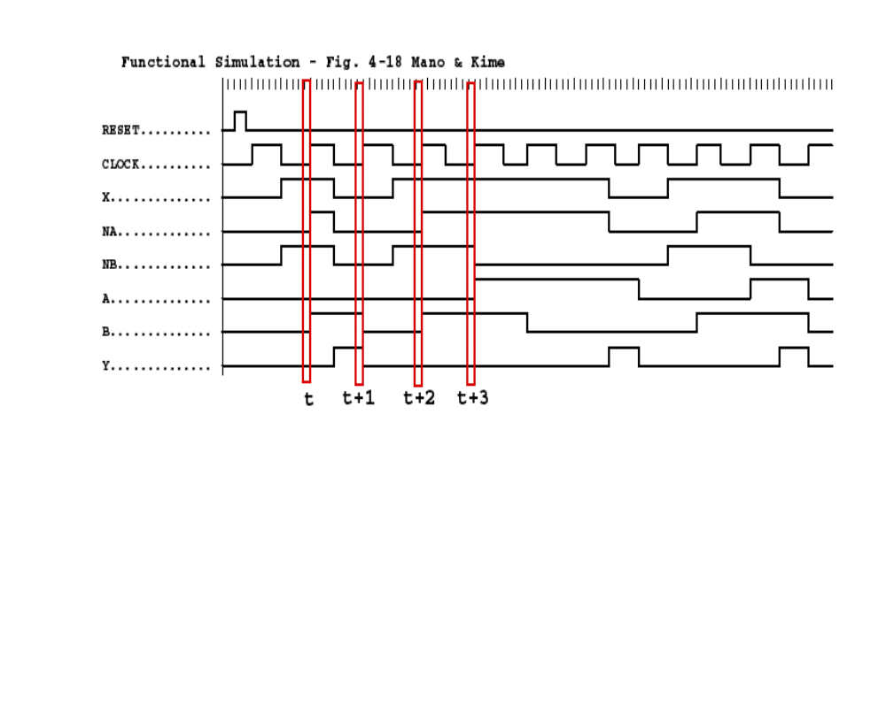
Example 1 (continued)
Where in time are inputs, outputs and states defined?
1
0
DA
DB
1
0
0
0
1
0
Chapter 5 - Part 1 <number>

Slide 39
State Table Characteristics
State table – a multiple variable table with the following four sections:
  Present State – the values of the state variables for each allowed state.
  Input – the input combinations allowed.
  Next-state – the value of the state at time (t+1) based on the present state and the input.
  Output – the value of the output as a function of the present state and (sometimes) the input.
From the viewpoint of a truth table:
  the inputs are Input, Present State
  and the outputs are Output, Next State
Chapter 5 - Part 1 <number>

Slide 40
Example 1: State Table (from Fig. 5-15)
The state table can be filled in using the next state and output equations: A(t+1) = A(t)x(t) + B(t)x(t)
B(t+1) =‾A (t)x(t) y(t) =‾x (t)(B(t) + A(t))
Present State |  | Input | Next State |  | Output
A(t) | B(t) | x(t) | A(t+1) | B(t+1) | y(t)
0 | 0 | 0 | 0 | 0 | 0
0 | 0 | 1 | 0 | 1 | 0
0 | 1 | 0 | 0 | 0 | 1
0 | 1 | 1 | 1 | 1 | 0
1 | 0 | 0 | 0 | 0 | 1
1 | 0 | 1 | 1 | 0 | 0
1 | 1 | 0 | 0 | 0 | 1
1 | 1 | 1 | 1 | 0 | 0
Chapter 5 - Part 1 <number>

Slide 41
Example 1: Alternative State Table
2-dimensional table that matches well to a K-map. Present state rows and input columns in Gray code order.
  A(t+1) = A(t)x(t) + B(t)x(t)
  B(t+1) =‾A (t)x(t)
  y(t) =‾x (t)(B(t) + A(t))
Present State
Next State
Output
x(t)=0 x(t)=1
x(t)=0 x(t)=1
A(t) B(t)
A(t+1)B(t+1) A(t+1)B(t+1)
y(t) y(t)
0 0
0 0 0 1
0 0
0 1
0 0 1 1
1 0
1 1
0 0 1 0
1 0
1 0
0 0
1 0
1 0
Chapter 5 - Part 1 <number>

Slide 42
State Diagrams
The sequential circuit function can be represented in graphical form as a state diagram with the following components:
  A circle with the state name in it for each state
  A directed arc from the Present State to the Next State for each state transition
  A label on each directed arc with the Input values which causes the state transition, and
  A label:
    On each circle with the output value produced, or
    On each directed arc with the output value produced.
Chapter 5 - Part 1 <number>

Slide 43
Example 1: State Diagram
x=0/y=0
x=0/y=1
x=1/y=0
A B
Which type?
0 0
x=0/y=1
1 0
x=1/y=0
x=1/y=0
Present State |  | Input | Next State |  | Output
A(t) | B(t) | x(t) | A(t+1) | B(t+1) | y(t)
0 | 0 | 0 | 0 | 0 | 0
0 | 0 | 1 | 0 | 1 | 0
0 | 1 | 0 | 0 | 0 | 1
0 | 1 | 1 | 1 | 1 | 0
1 | 0 | 0 | 0 | 0 | 1
1 | 0 | 1 | 1 | 0 | 0
1 | 1 | 0 | 0 | 0 | 1
1 | 1 | 1 | 1 | 0 | 0
x=0/y=1
0 1
1 1
x=1/y=0
Chapter 5 - Part 1 <number>

Slide 44
Moore and Mealy Models
Sequential Circuits or Sequential Machines are also called Finite State Machines (FSMs). Two models exist:
In real design, models are sometimes mixed Moore and Mealy
Moore Model
  Named after E.F. Moore.
  Outputs are a function ONLY of states
  Usually specified on the states.
Mealy Model
  Named after G. Mealy
  Outputs are a function of inputs AND states
  Usually specified on the state transition arcs.
Chapter 5 - Part 1 <number>

Slide 45
Moore and Mealy Example Diagrams
State Diagram of Mealy Model
maps inputs and state to outputs
State Diagram of Moore Model maps states to outputs
x=1/y=0
x=0/y=0
0
1
x=0/y=0
x=1/y=1
x=0
00/0
x=0
x=1
x=1
x=0
01/0
10/1
x=1
Chapter 5 - Part 1 <number>

Slide 46
Moore and Mealy Example Tables
Mealy Model state table maps inputs and state to outputs
Moore Model state table maps state to outputs
Present
State
Next State
Output
x=0 x=1
x=0 x=1
0
0 1
0 0
1
0 1
0 1
Present
State
Next State
Output
x=0 x=1
00
00 01
0
01
00 10
0
10
00 10
1
Chapter 5 - Part 1 <number>

Slide 47
Sequential Circuit Analysis
Sequential Circuit Analysis is an procedure of specifying the logic diagram of a given sequential circuit.
A state table and state diagram are presented to describe the behavior of the circuit, demonstrate the time sequence of inputs, outputs and states, and illustrate the functionality of the given circuits.
Chapter 5 - Part 1 <number>

Slide 48
Sequential Circuit Analysis Procedure
1. Derive the output equations，excitation equations and Next state functions
2. Derive the truth table with state:
Inputs: inputs of circuit, present state of the circuit
Outputs: outputs of circuit, next state of all flip-fops
3. List the next state of the sequential circuit
4. Obtain a state diagram
5. Analyze the external performance of the circuit
6. Verify the correctness of the circuit, check the self-recovery capability and draw the timing parameters
Chapter 5 - Part 1 <number>

Slide 49
Example 2: Sequential Circuit Analysis
A
Logic Diagram:
D
Q
Z
C
R
Q
B
D
Q
C
R
Q
C
D
Q
Clock
C
R
Q
Reset
Chapter 5 - Part 1 <number>

Slide 50
Example 2: Flip-Flop Input Equations
Variables
  Inputs: None
  Outputs: Z
  State Variables: A, B, C
Initialization: Reset to (0,0,0)
Equations
  A(t+1) = Z =
  B(t+1) =
  C(t+1) =
Chapter 5 - Part 1 <number>

Slide 51
Example 2: Flip-Flop Input Equations
Variables
  Inputs: None
  Outputs: Z
  State Variables: A, B, C
Initialization: Reset to (0,0,0)
Equations
  A(t+1) = B(t)C(t) Z = A(t)
  B(t+1) = B(t)C(t) + B(t)C(t)
  C(t+1) = A(t)C(t)
Chapter 5 - Part 1 <number>
Notes:
A(t+1) = BC
B(t+1) = B’C + BC’
C(t+1) = A’C’
Z = A

Slide 52
Example 2: State Table
X’ = X(t+1)
A B C | A’B’C’ | Z
0 0 0
0 0 1
0 1 0
0 1 1
1 0 0
1 0 1
1 1 0
1 1 1
Chapter 5 - Part 1 <number>
Notes:
A’B’C’: 0 0 1, 0 1 0, 0 1 1, 1 0 0, 0 0 0, 0 1 0, 0 1 0, 1 0 0
Z: 0 0 0 0 1 1 1 1

Slide 53
Example 2: State Table
X’ = X(t+1)
A B C | A’B’C’ | Z
0 0 0 | 0 0 1 | 0
0 0 1 | 0 1 0 | 0
0 1 0 | 0 1 1 | 0
0 1 1 | 1 0 0 | 0
1 0 0 | 0 0 0 | 1
1 0 1 | 0 1 0 | 1
1 1 0 | 0 1 0 | 1
1 1 1 | 1 0 0 | 1
Chapter 5 - Part 1 <number>
Notes:
A’B’C’: 0 0 1, 0 1 0, 0 1 1, 1 0 0, 0 0 0, 0 1 0, 0 1 0, 1 0 0
Z: 0 0 0 0 1 1 1 1

Slide 54
Example 2: State Diagram
Which states are used?
What is the function of
the circuit?
Does it have self-recovery capability?
ABC
Reset
000/0
111/1
100/1
001/0
011/0
010/0
101/1
110/1
Chapter 5 - Part 1 <number>

Slide 55
Circuit and System Level Timing
Consider a system
consists of flip-flops
connected by logic:
If the clock period is
too short, data changes may not be able to
propagate through the
circuit to flip-flop inputs before the setup
time interval begins
D
Q
D
Q
C
Q'
C
Q'
D
Q
D
Q
C
Q'
C
Q'
D
Q
D
Q
C
Q'
C
Q'
D
Q
D
Q
C
Q'
C
Q'
D
Q
D
Q
C
Q'
C
Q'
CLOCK
CLOCK
Chapter 5 - Part 1 <number>

Slide 56
Circuit and System Level Timing (continued)
Timing components along a path from flip-flop to flip-flop
t
p
C
t
pd,FF
t
pd,COMB
t
t
s
slack
(a) Edge-triggered (positive edge)
t
p
C
t
pd,FF
t
pd,COMB
t
t
slack
s
(b) Pulse-triggered (negative pulse)
Chapter 5 - Part 1 <number>
Notes:
图6-8

Slide 57
Circuit and System Level Timing (continued)
New Timing Components
  t_{p} - clock period - The interval between occurrences of a specific clock edge in a periodic clock
  t_{pd,COMB} - total delay of combinational logic along the path from flip-flop output to flip-flop input
  t_{slack} - extra time in the clock period in addition to the sum of the delays and setup time on a path
    Can be either positive or negative
    Must be greater than or equal to zero on all paths for correct operation
Chapter 5 - Part 1 <number>

Slide 58
Circuit and System Level Timing (continued)
Timing Equations
t_{p} = t_{slack} + (t_{pd,FF} + t_{pd,COMB} + t_{s})
  For t_{slack} greater than or equal to zero,
  t_{p} ≥ max (t_{pd,FF} + t_{pd,COMB} + t_{s})
  for all paths from flip-flop output to flip-flop input
Can be calculated more precisely by using t_{PHL} and t_{PLH} instead of t_{pd} , but requires consideration of inversions through paths
Chapter 5 - Part 1 <number>

Slide 59
Calculation of Allowable t_{pd,COMB}
Compare the allowable combinational delay for a specific circuit:
a) Using edge-triggered flip-flops
b) Using master-slave flip-flops
Parameters
  t_{pd,FF}(max) = 1.0 ns
  t_{s}(max) = 0.3 ns for edge-triggered flip-flops
  t_{s} = t_{wH} = 2.0 ns for master-slave flip-flops
  Clock frequency = 250 MHz
Chapter 5 - Part 1 <number>

Slide 60
Calculation of Allowable t_{pd,COMB} (continued)
Calculations: t_{p} = 1/clock frequency = 4.0 ns
  Edge-triggered: 4.0 ≥ 1.0 + t_{pd,COMB} + 0.3, t_{pd,COMB} ≤ 2.7 ns
  Master-slave: 4.0 ≥ 1.0 + t_{pd,COMB} + 2.0,
  t_{pd,COMB} ≤ 1.0 ns
Comparison: Suppose that for a gate, average t_{pd} = 0.3 ns
  Edge-triggered: Approximately 9 gates allowed on a path
  Master-slave: Approximately 3 gates allowed on a path
Chapter 5 - Part 1 <number>

Slide 61


Assignment
Reading: pp. 208-230, 306-310
Problems:
  4-7、4-8
  4-13、4-21、4-22、4-25,4-29
Chapter 5 <number>

